Slide 1
Data Structure and Algorithm.
Time complexity
By Shohoz Skill

Slide 2
WE WILL TALK ABOUT
Time complexity
Time complexity is the computational complexity that describes the amount of computer time it takes to run an algorithm.
OR,,,
Time complexity is a way of measuring how the runtime of a program or algorithm grows as the input size increases.

Slide 3
DID YOU
KNOW?
It helps us understand how efficient an algorithm is by analyzing how many operations it needs to perform relative to the size of the input. So, the lower the time complexity, the faster the algorithm runs, which is generally what we're aiming for.

Slide 4
Problem - 1
1 print(Hello World!)
Problem - 4
1 print(Hello World!)
2
3 print(Hello World!)
4
5 print(Hello World!)
6
7 print(Hello World!)
8
9 print(Hello World!)
10
Problem - 2
1 int a = 5;
2 print(a);
Problem - 3
1 int a = 5,b = 6;
2 sum = a+b;
3 print(sum);

Slide 5
Problem - 5
1 for(i = 0; i < n; i++)
Or
1 for(i = n; i > 0; i--)
Problem - 7
1 for(i = 1; i < n; i++){
2 //Statement
3 {
Problem - 6
1 for(i = 0; i < n; i++){
2 //Statement
3 }

Slide 6
Problem - 8
1 for(i = 0; i < n; i++){
2 for(j = 0; j < n; j++){
3 //Statement
4 }
5 }
Problem - 9
1 for(i = 1; i < n; i++){
2 //Statement
3 {
4
5 for(j = 0; j < n; j++){
6 //Statement
7 }

Slide 7
Problem - 10
1 for(i = 0; i < n; i=i+2){
2 //Statement
3 }
Or,
1 for(i = n; i > 0; i=i-2){
2 //Statement
3 }

Slide 8
Problem - 11
1 for(i = 1; i < n; i=i*2){
2 //Statement
3 }
or,
1 for(i = n; i > 1; i=i/2){
2 //Statement
3 }

Slide 9
Problem - 12
1 for(i = 0; i < n; i=i*2){
2 for(j = 0; j < n; j=j*2){
3 //Statement
4 }
5 }
Problem - 13
1 for(i = 1; i < n; i=i*2){
2 //Statement
3 }
4
5 for(j = 0; j < n; j=j/2){
6 //Statement
7 }

Slide 10
Problem - 14
1 for(i = 3; i <= n; i=i*i){
2 //Statement
3 }
Or,
1 for(i = n; i >= 3; i=i/i){
2 //Statement
3 }

Slide 11
Problem - 15
1 for (i = 0; i*i<n; i++){
2 //Statement
3 }
Problem - 16
1 for(i = 0; i*i < n; i++){
2 for(j = 0; j*j < n; j++){
3 //Statement
4 }
5 }

Slide 12
Different types of time of Time complexity
1.n 1.for(i = 0; i < n;i++)
2.for(i = n; i > 0;i--)
2.log(n) 1.for(i = 1;i < n;i=*c)
2.for(i = n;i > 1;i=/c)
3.(n/2) 1.for(i = 0;i < n;i=+c)
2.for(i = n;i > 0;i=-c)
4.(sqrt(n)) 1.for (i = 0; i*i<n; i++)
5.(loglog(n)) 1.for(i = c; i <= n; i=i*i)
2.for(i = c; i >= 3; i=i/i)

Slide 13
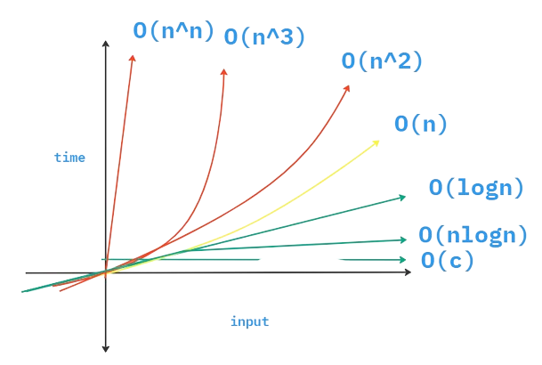
Different types of time of Time complexity

Slide 14
For Loop
1 for(i = 0;i < n; i++){
2 //Statement
3 }
D0-While Loop
1 i = 0;
2 do{
3 //Statement
4 i++;
5 }while(i < n)
While Loop
1 i = 0;
2 while(i < n){
3 //Statement
4 i++;
5 }

Slide 15
Problem - 17
1 for(i = 0; i < n; i=i+2){
2 for(j = n; j > 1; j=j/2){
3 //Statement
4 }
5 }

Slide 16
Problem - 18
1 i = 1
2 k = 1
3 while(){
4 k=k+i;
5 i++;
6 }
or,
1 for (i = 0; i*i<n; i++){
2 k=k+i;
3 i++;
4 }

Slide 17
Problem - 19
1 for (i = 0; i < n; i++){
2 for (j = 0; j < n; j++){
3 a=a+j;
4 }
5
6 for (k = 0; k < n; k++){
7 b=b+k;
8 }

Slide 18
Problem - 20
1 for (i = 0; i < n; i++){
2 for (j = n; j > i; j--){
3 a=a+i+j;
4 }

Slide 19
Problem - 21
1 for(i = n; i>1; i/=3)
2 for(j = 0; j <n ; j+=2)
3 print(Hello)
4 }
5 }
6
7 for( k = 3;k < n; k++)
8 print(hello)
9 }

Slide 20
Problem - 22
1 void fun(n){
2 while(i < n){
3 j = n;
4 while(j>0)
5 j = j / 2
6 i = 2 * i
7 }
8 }
9 }

Slide 21
Thank you
Do you have any questions?
-> comment down below.
Like. share. subscribe

